Slide 1


Letter Recognition
Machine Learning Project
- Shalini Bardhan

Slide 2
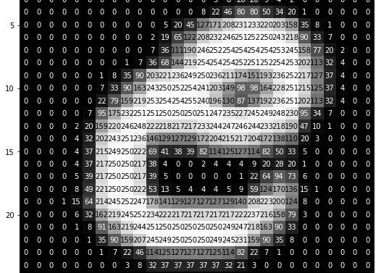
Problem Statement
The objective is to identify each large number of black-and-white rectangular pixel displays as one of the 26 capital letters in the English alphabet.

Slide 3
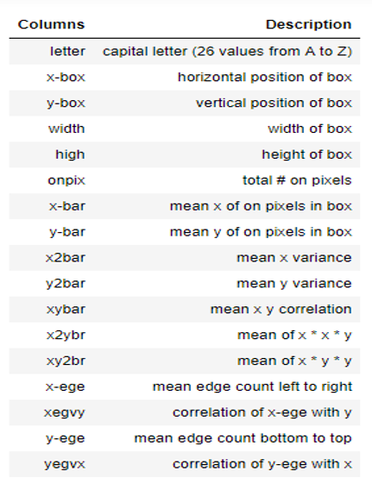
DATASET
Rows x Columns(16000 x 18)
Train dataset: 16000 records
Rows x Columns(3999 x 17)
Test dataset: 3999 records
Prediction : letter

Slide 4
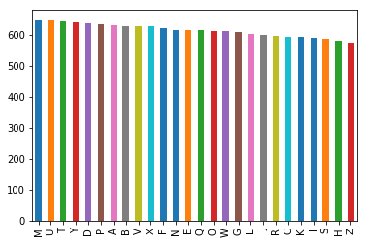
Exploratory Data Analysis
There are no null or missing values in our dataset.
We plotted a graph to see the frequency of each alphabet in our dataset ( i.e the count of each character in our dataset ) [ Fig. below]

Slide 5
EDA continued…
We drop the ID column from both the training and testing dataset, as it won’t be necessary for our prediction analysis.
1
After cleaning our data, we plot a histogram to see the visualization of the attributes/ columns. [Fig. in next slide]
2

Slide 6
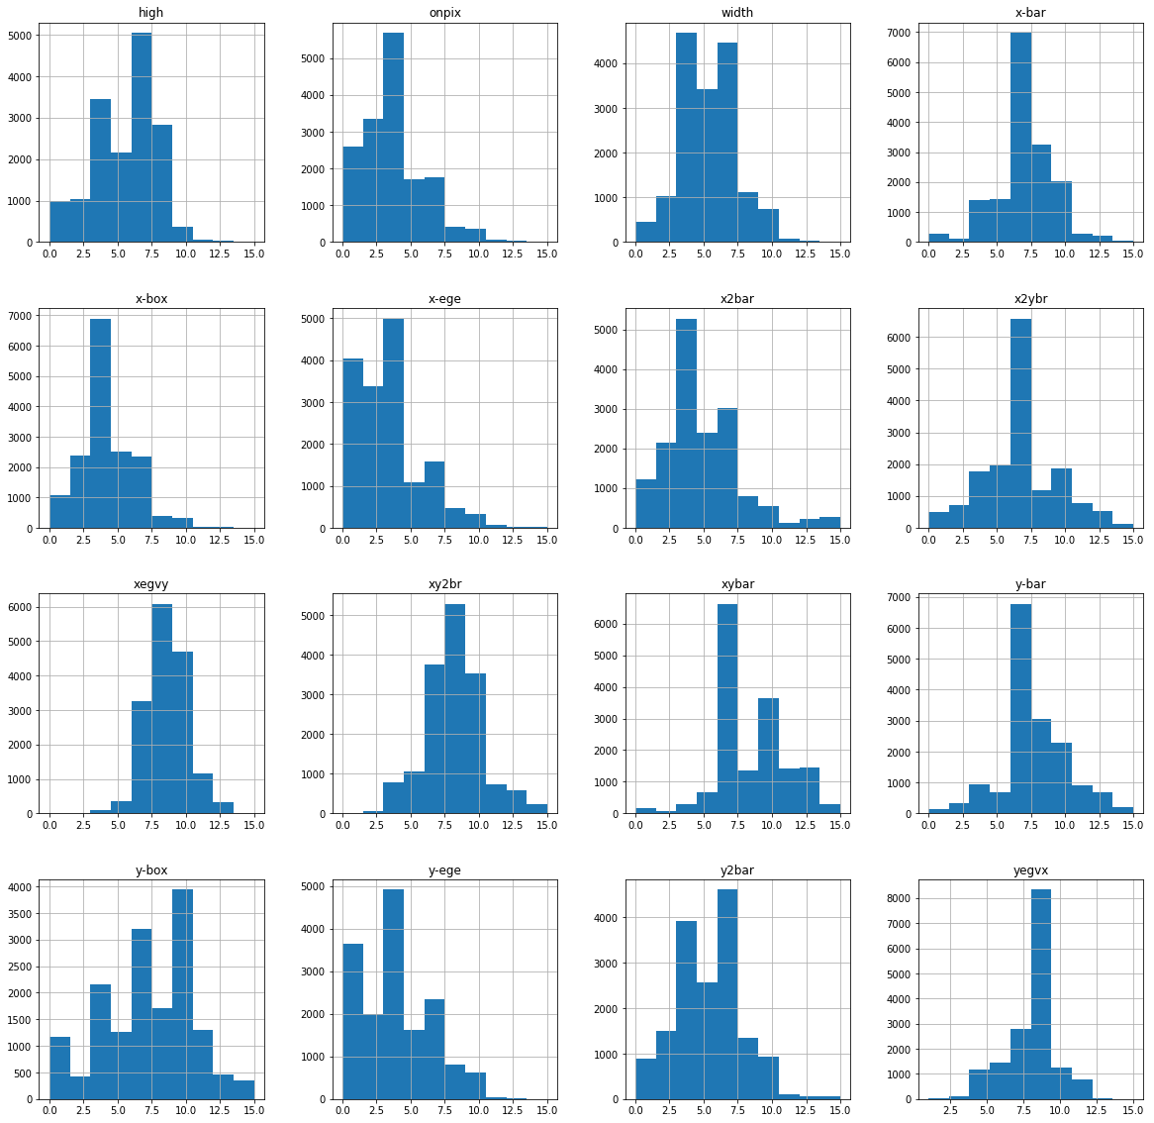

Slide 7
Machine Learning Models Used
1.) Random Forest Classifier
2.) K-Nearest Neighbour (KNN)
3.) XGBOOST Classifier
4.) Support Vector Classifier
5.) Ensemble Learning Algorithm

Slide 8
Accuracy Score
ALGORITHM | ACCURACY
Random Forest Classifier | 96.21875
K-Nearest Neighbour | 94.5625
XGBoost Classifier | 87.94
Support Vector Classifier | 97.28
Ensemble – Model 1 ( RFC,KNN & SVC ) | 96.125
Ensemble – Model 2 ( RFC & SVC ) | 93.59375
From the above accuracy table we can conclude that Support Vector Classifier ( SVC ) model gives the highest accuracy as far as the training data set is concerned.
It is followed by Random Forest Classifier ( RFC ) model with an accuracy of 96.21% .

Slide 9
CONCLUSION
We trained our model and predicted/recognized the letters with the help of test dataset.
SVC Algorithm provides the maximum accuracy , followed by the RFC ( Random Forest Classifier ) Algorithm.
Comparing the output files and calculating the difference, we found that 3825 records are predicted correctly out of the total 3999 (taking SVC model as reference).

Slide 10


